Slide 1

Resume Lens:
Formal Language-Based Resume Screening System
Automated Candidate Evaluation Pipeline using Regex, FSTs, Automata, and textX DSL
Krystal Giraldo
Valeria Piza
Miguel Pabón
Universidad Icesi

Slide 2









Problem Statement
& Motivation
Manual screening is slow
Time-consuming and hard to scale
Extract
Normalize
Validate
Classify
Outcomes are inconsistent
Prone to human error and bias
Capture information from resumes
Standardize formats and terminology
Check data quality and condistency
Match to roles and rank candidates
Our solution
A compilerlike pipeline that processes resumes end-to-end
Built for key engineering roles
Full Stack, Machine Learning,
DevOps, and NLP Engineers

Slide 3
















System Architecture
The 5-Stage Pipeline
An end-to-end flow that transforms raw resumes into structured insights and results.
01
02
03
04
05
Extraction
Normalizeation
Classification
Specification
Visualization
Capture information from resumes
Standardize formats and terminology
Categorize and rank candidates
Map results to formal specifications
Present insights in a clear format
Regex
Automata

Slide 4


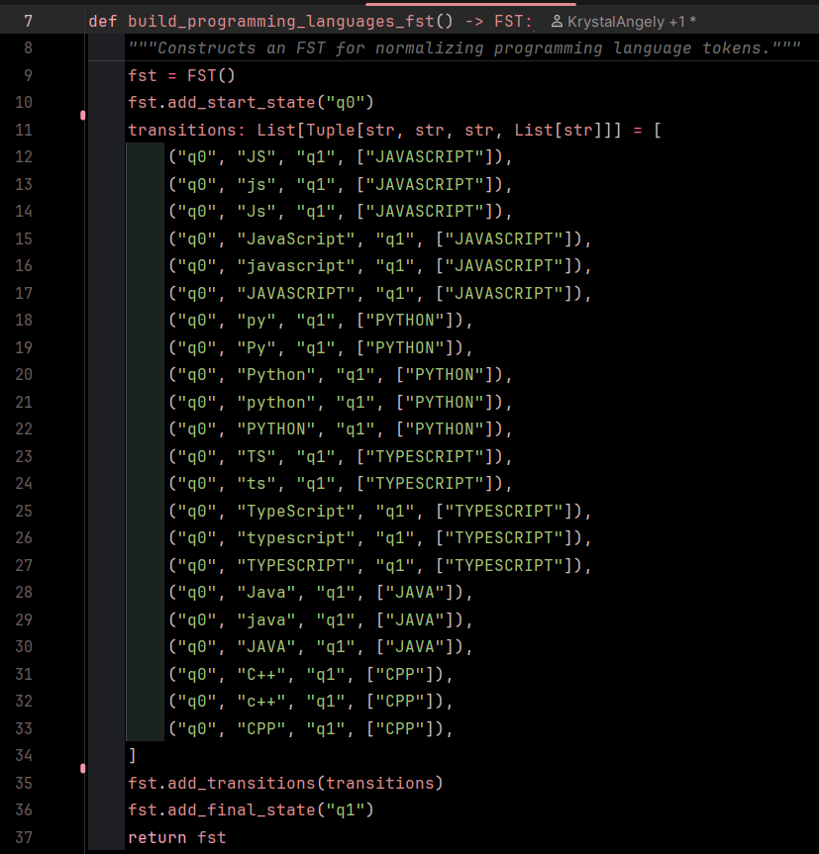


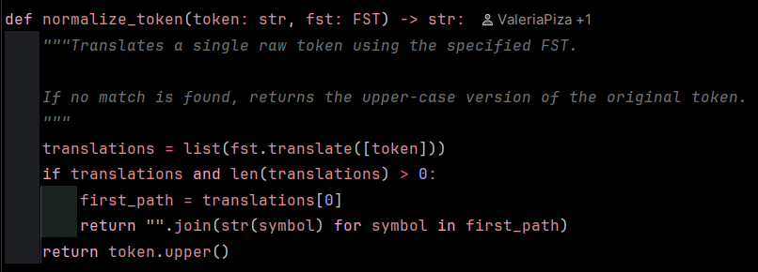



Stage 1 & 2 — Extraction &
FST Normalization
Extract contacts, skills, experience, and education with regex patterns
Normalize tool variants using
finite-state transducers (FST)
Translate variants like ‘react.js’ and ‘k8s’
into canonical tokens like ‘REACT’ and ‘KUBERNETES’
Stage 1
Regex
Extraction
Stage 2
FST Normalization
Normalized
Tokens

Slide 5


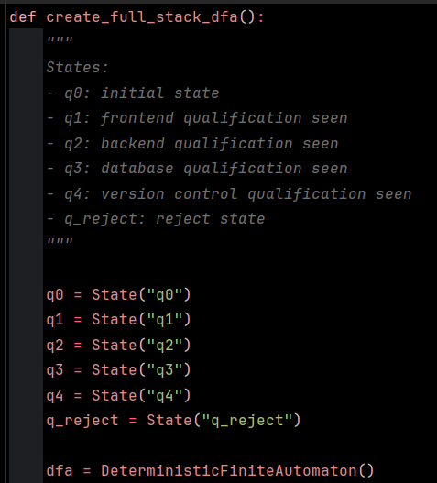


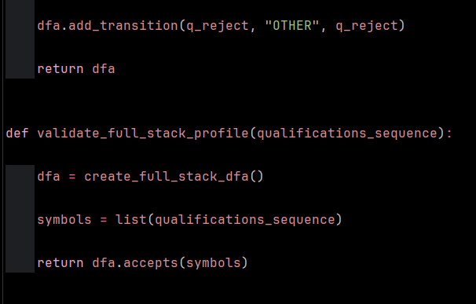
Stage 3 —
Classification via Automata
DFA-based validation of skill sequences
Evaluates ordered, canonical skills extracted from resumes
Enforces track-specific prerequisites
Ensures structural requirements for each professional path
Deterministic and interpretable
Clear state transitions and acceptance conditions for reliable classification

Slide 6



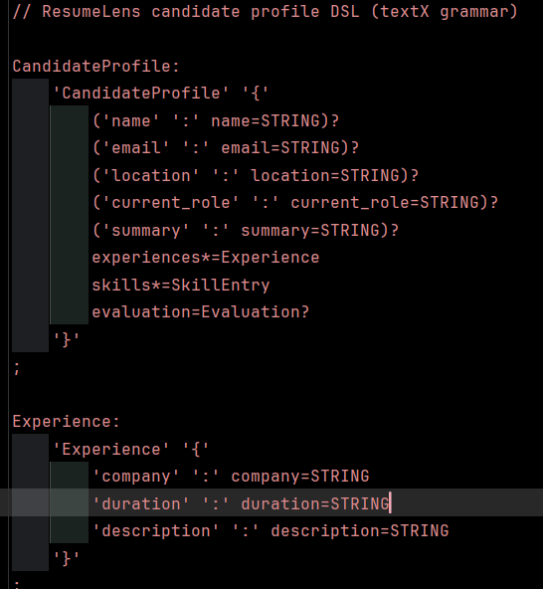








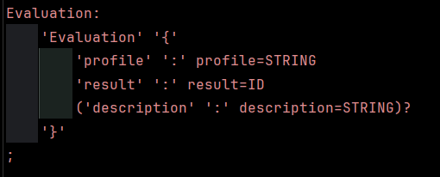

Stage 4 & 5 —
DSL Specification & HTML Visualization
resume_dsl.tx
Formal DSL with textX
01
The resume_dsl.tx grammar enforces structural, lexical, and semantic rules on candidate profiles
Candidate Report
02
Consistent evaluation
Alex Johnson
PASS
The DSL ensures uniform validation and reliable scoring across resumes
Education
Pass
Experience
Pass
Clear HTML reports
Skills
Pass
03
Automated, modern HTML reports highlight pass/fail results and details
Overall Score
87

Slide 7



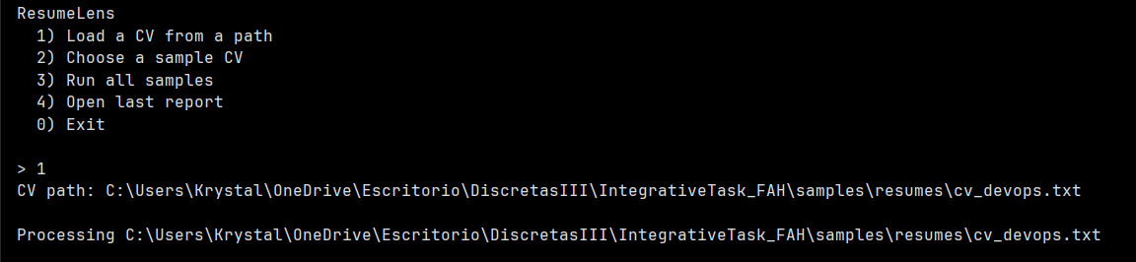
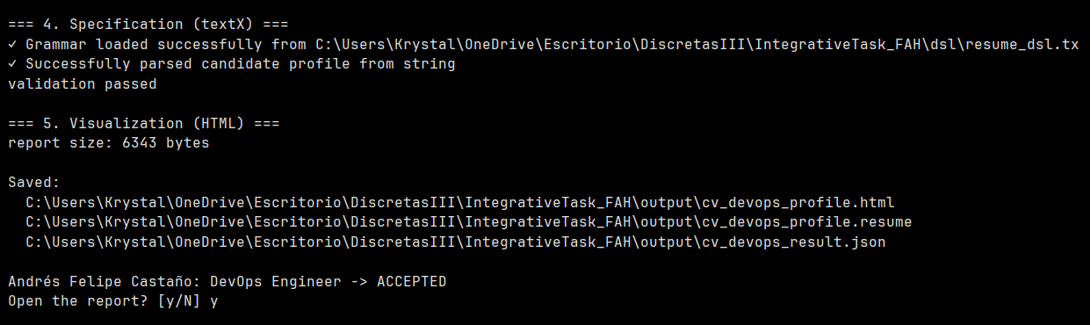
Interactive CLI
& User Experience
Simple, guided interface
Clear menu to load, select,
and run with confidence
Flexible input
Load your own CVs or
choose from sample resumes
Instant feedback
Results summary with status, matches, and ranking

Slide 8




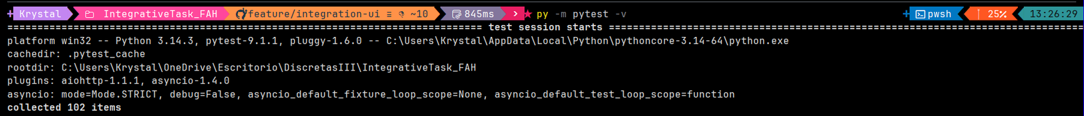
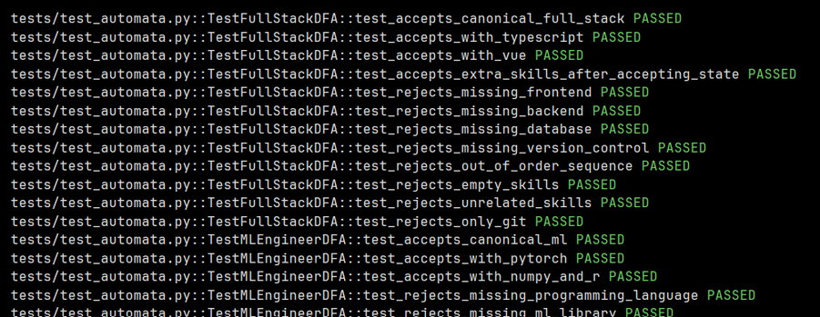
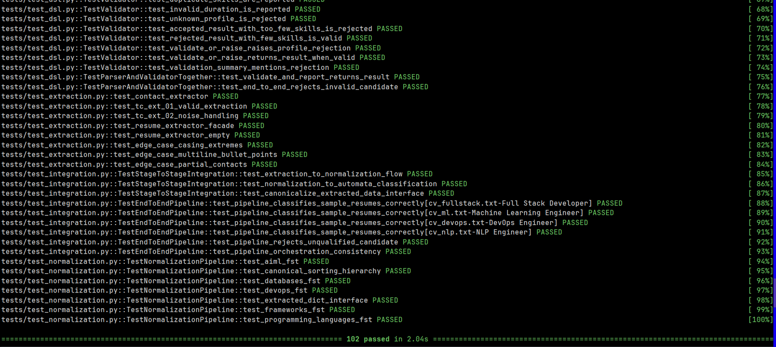
Rigorous Testing & Quality Assurance
Comprehensive coverage
Automated tests across all pipeline layers
102 test cases passing
100% success rate
Built to high standards
Full type hinting and code
style enforcement

Slide 9


Conclusion & Key Takeaways
Formal language theory
powers practical recruitment tooling
Modular architecture
built for maintainability and extensibility
High test coverage
and robust error handling
Reliable by design,
ready for real-world impact

Slide 10



Q&A
Thank you.
Open floor for questions.

